Slide 1
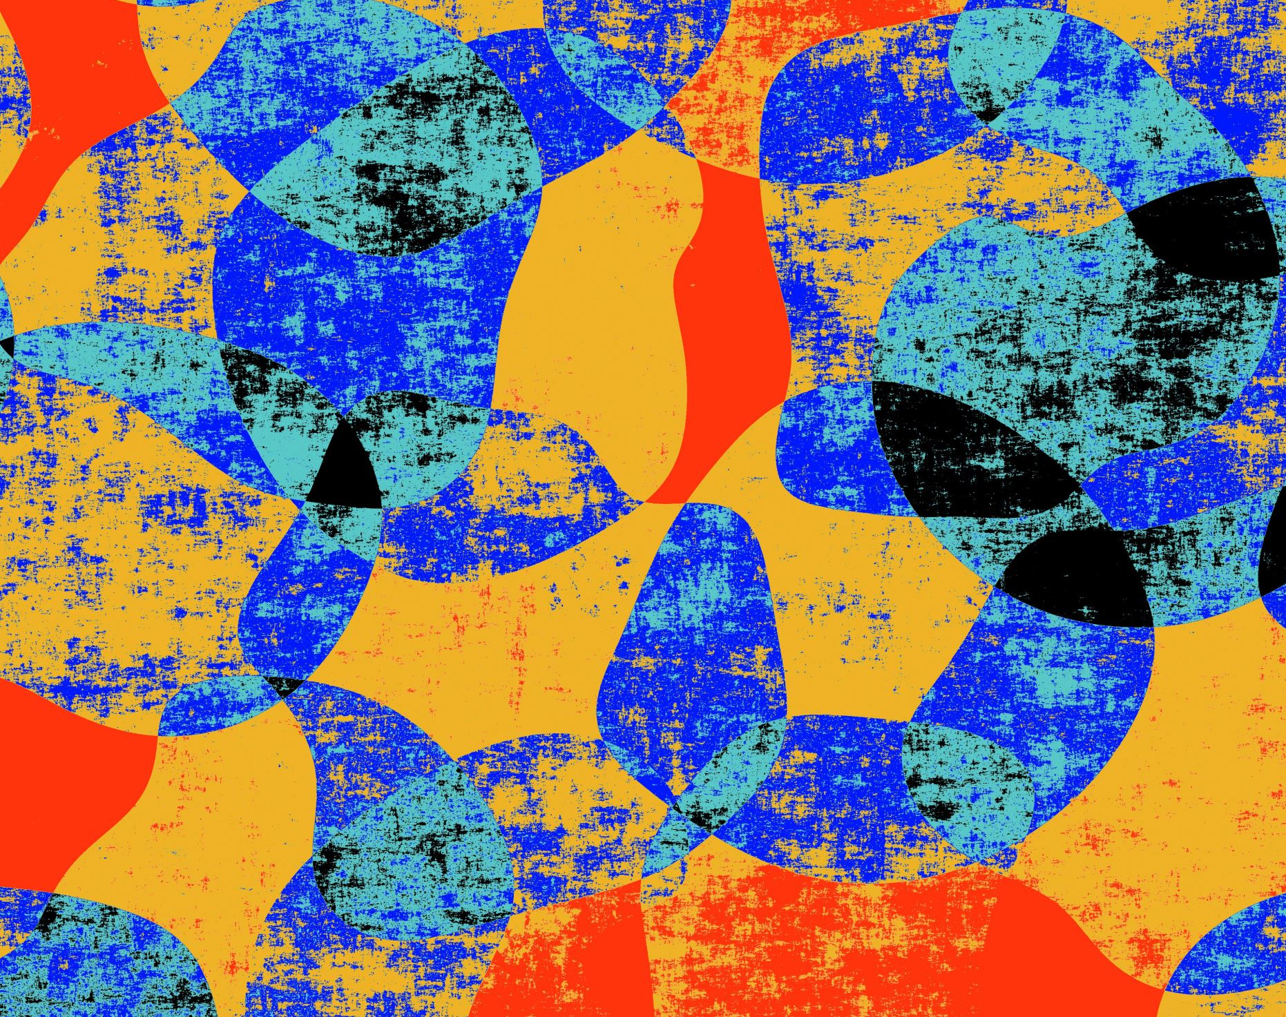
Deep Learning Final Project- Diabetic Retinopathy
Prepared By
-Yogita Nesargi
-Blessing Ajiboye

Slide 2
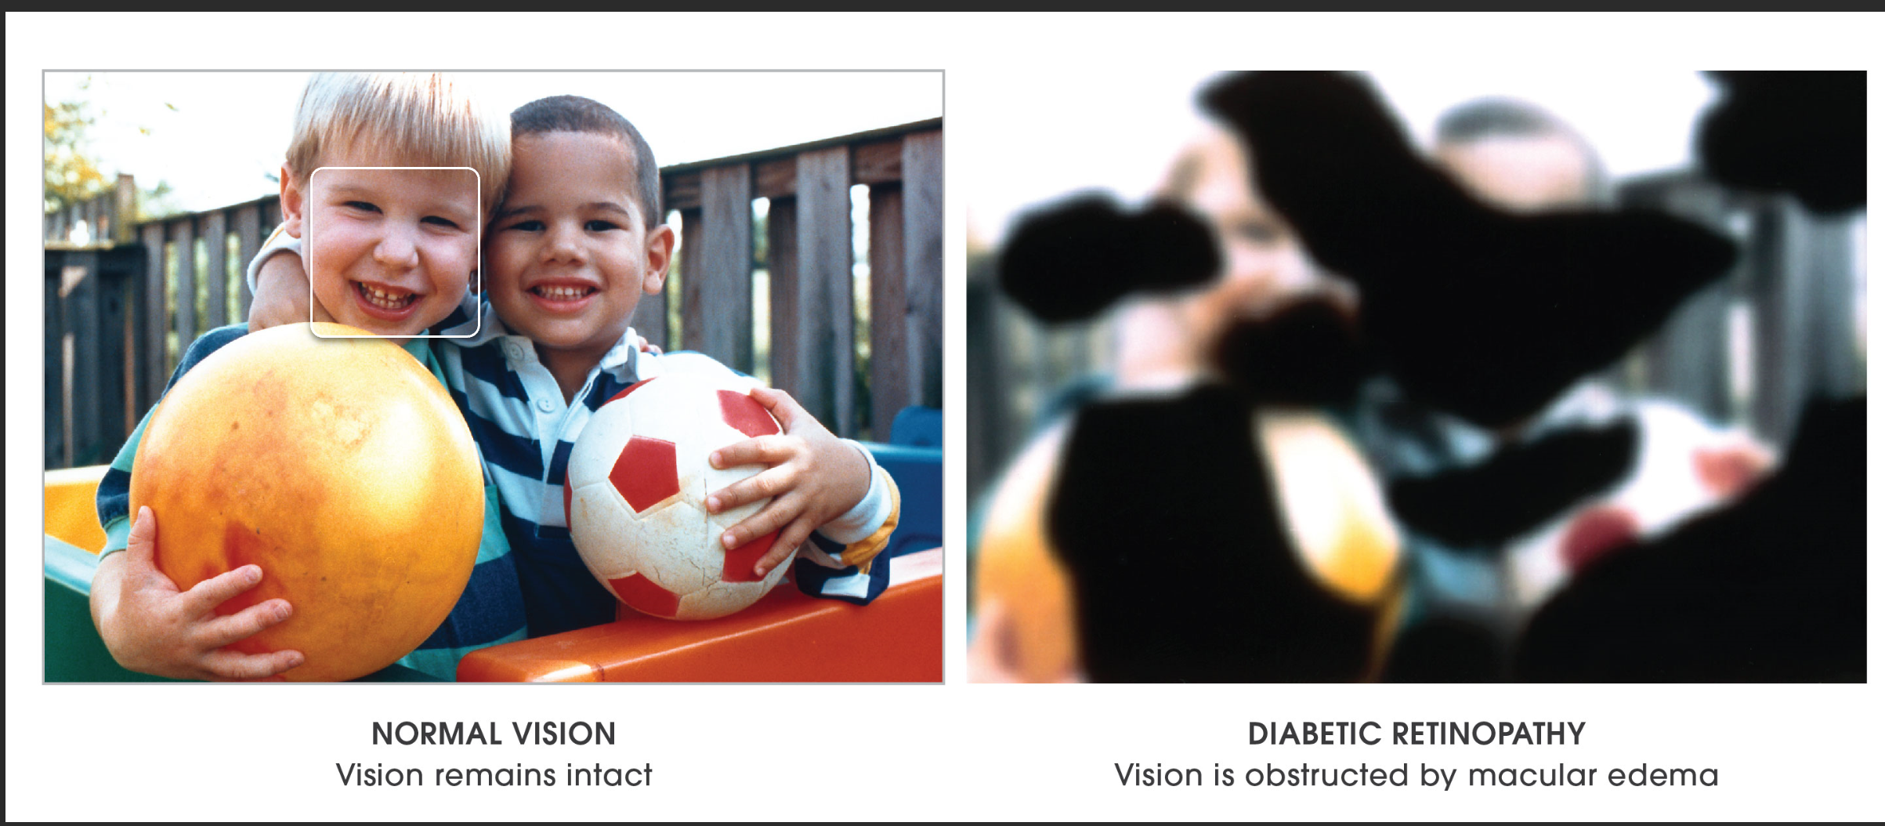
What is Diabetic Retinopathy?
Diabetic retinopathy (die-uh-BET-ik ret-ih-NOP-uh-thee) is a diabetes complication that affects eyes. It's caused by damage to the blood vessels of the light-sensitive tissue at the back of the eye (retina).
At first, diabetic retinopathy may cause no symptoms or only mild vision problems. Eventually, it can cause blindness.
The condition can develop in anyone who has type 1 or type 2 diabetes. The longer you have diabetes and the less controlled your blood sugar is, the more likely you are to develop this eye complication.

Slide 3
Diabetic Retinopathy in AI world
The diagnosis of diabetic retinopathy (DR) through color fundus images requires experienced clinicians to identify the presence and significance of many small features which, along with a complex grading system, makes this a difficult and time-consuming task. In this project, we propose a CNN approach to diagnosing DR from digital fundus images and accurately classifying its severity. We develop a network with CNN architecture and data augmentation which can identify the intricate features involved in the classification task such as micro-aneurysms, exudate and hemorrhages on the retina and consequently provide a diagnosis automatically and without user input. We train this network using on the publicly available Kaggle dataset. On the data set of 35,000 images used our proposed CNN achieves an accuracy of 74% on 3,500 validation images.

Slide 4
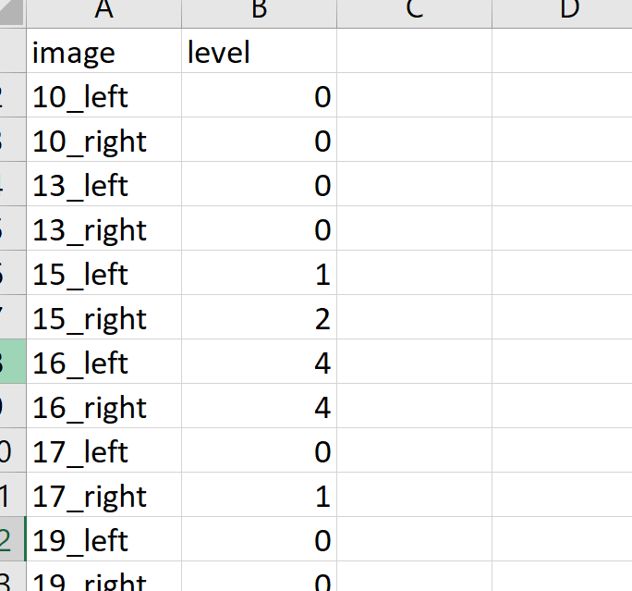
Peak into the data
Data downloaded from Kaggle includes 35000 images and csv file containing the labels for those images
There are 5 types of labels 0/1/2/3/4, they are distinguished as below
Class Name
0 Normal
1 Mild NPDR
2 Moderate NPDR
3 Severe NPDR
4 PDR

Slide 5
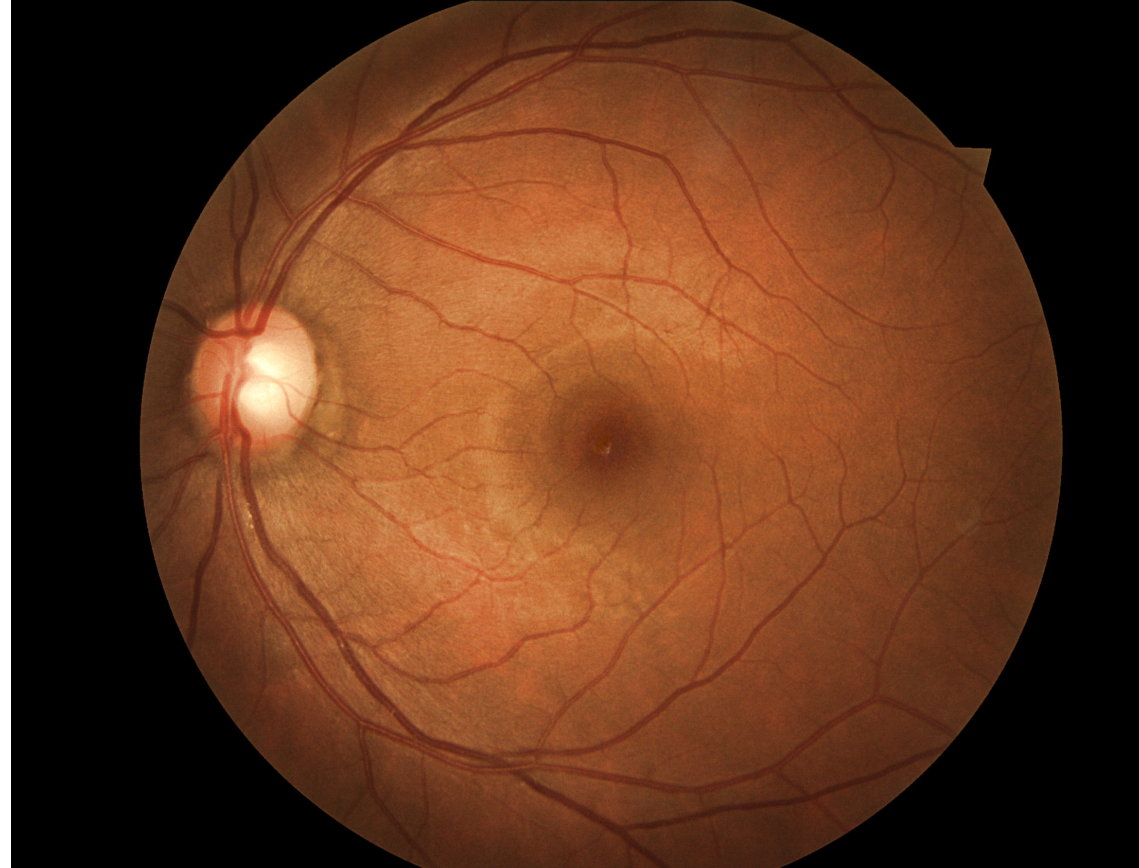
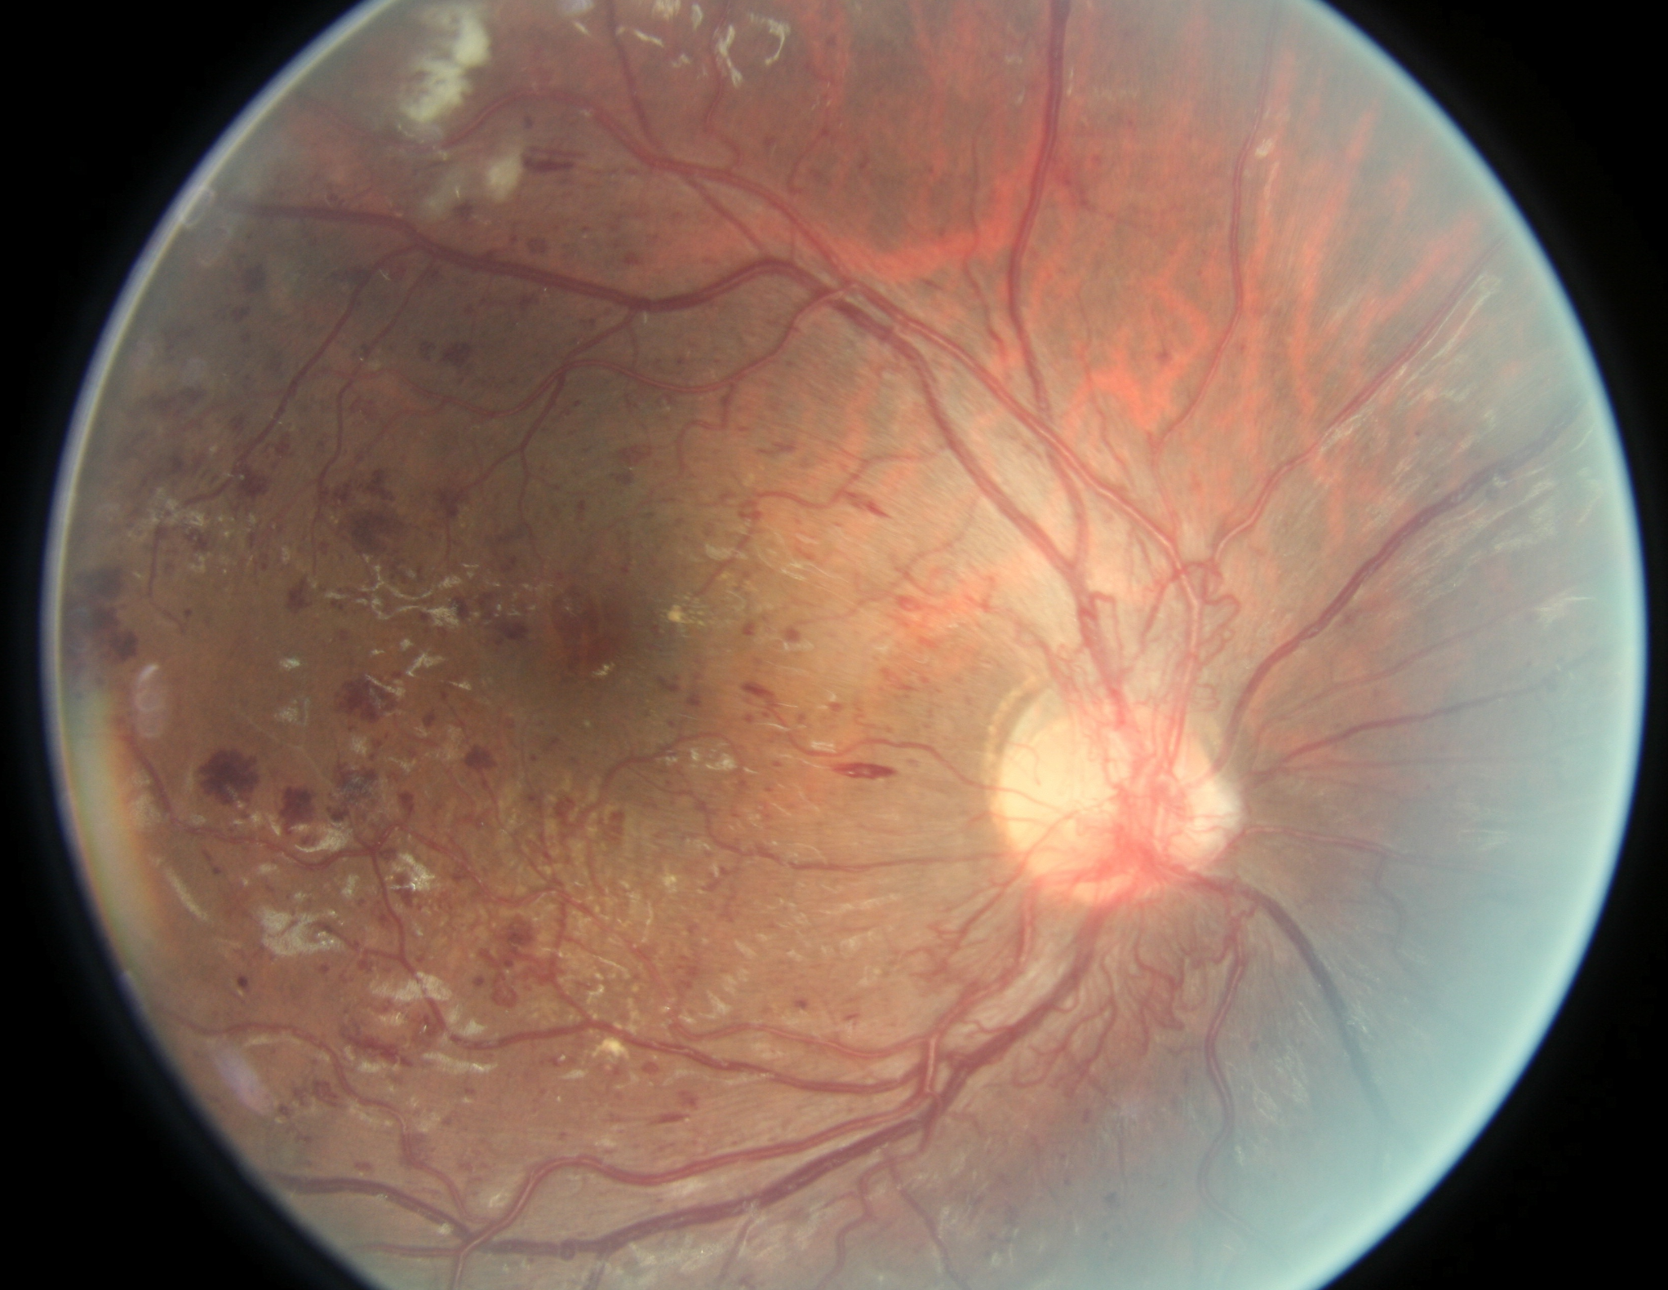
Eye images from the Dataset
Normal Eye Image
Stage 4 DR Eye Image

Slide 6
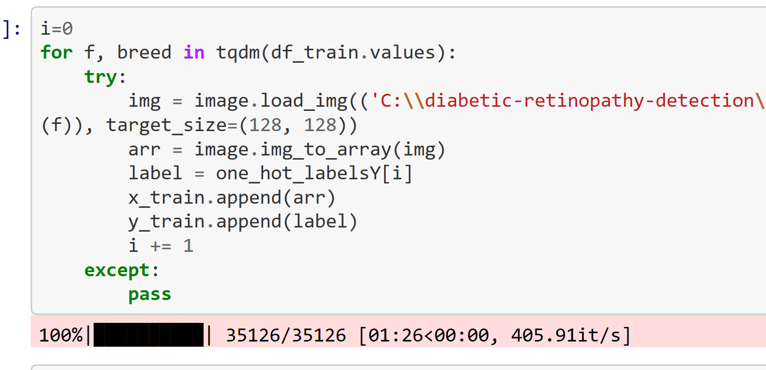
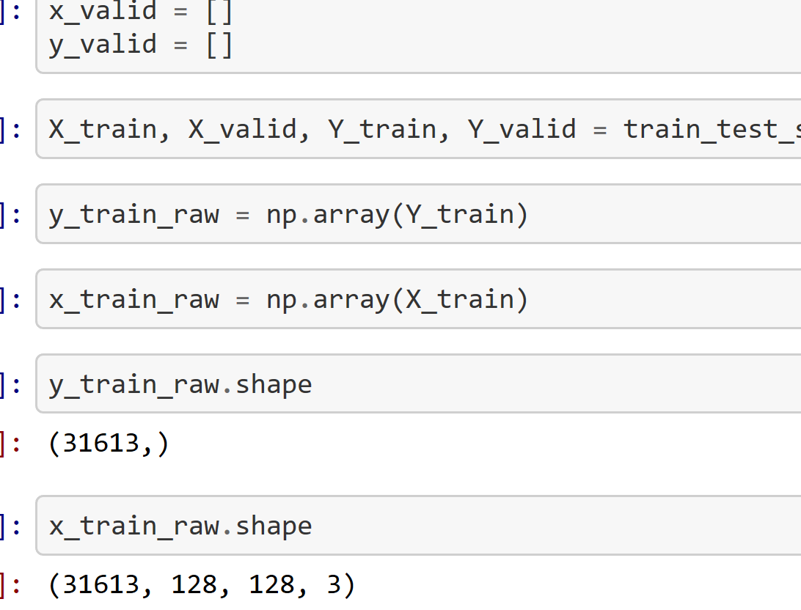
Data Augmentation
Prior to feeding the images to CNN images need to cropped and resized to 128 * 128 size. This has significantly reduced the computation time from 1 hour to less than 2 minutes for 35000 images

Slide 7
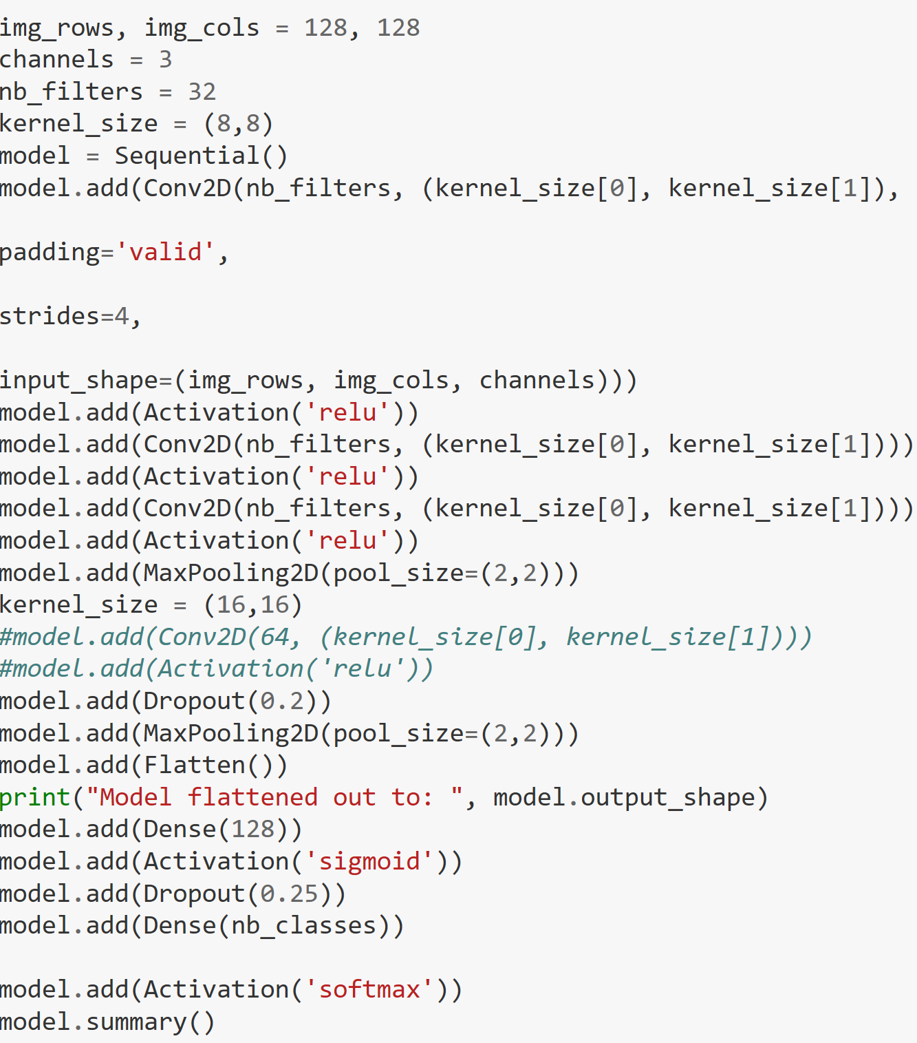
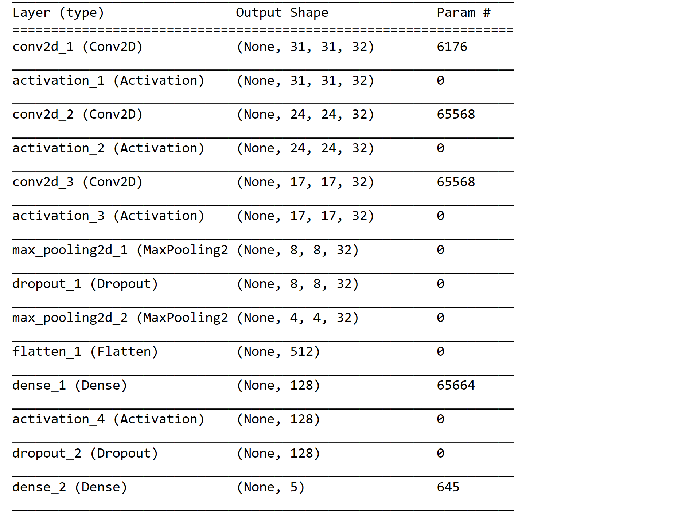
Convoluted Neural Network

Slide 8
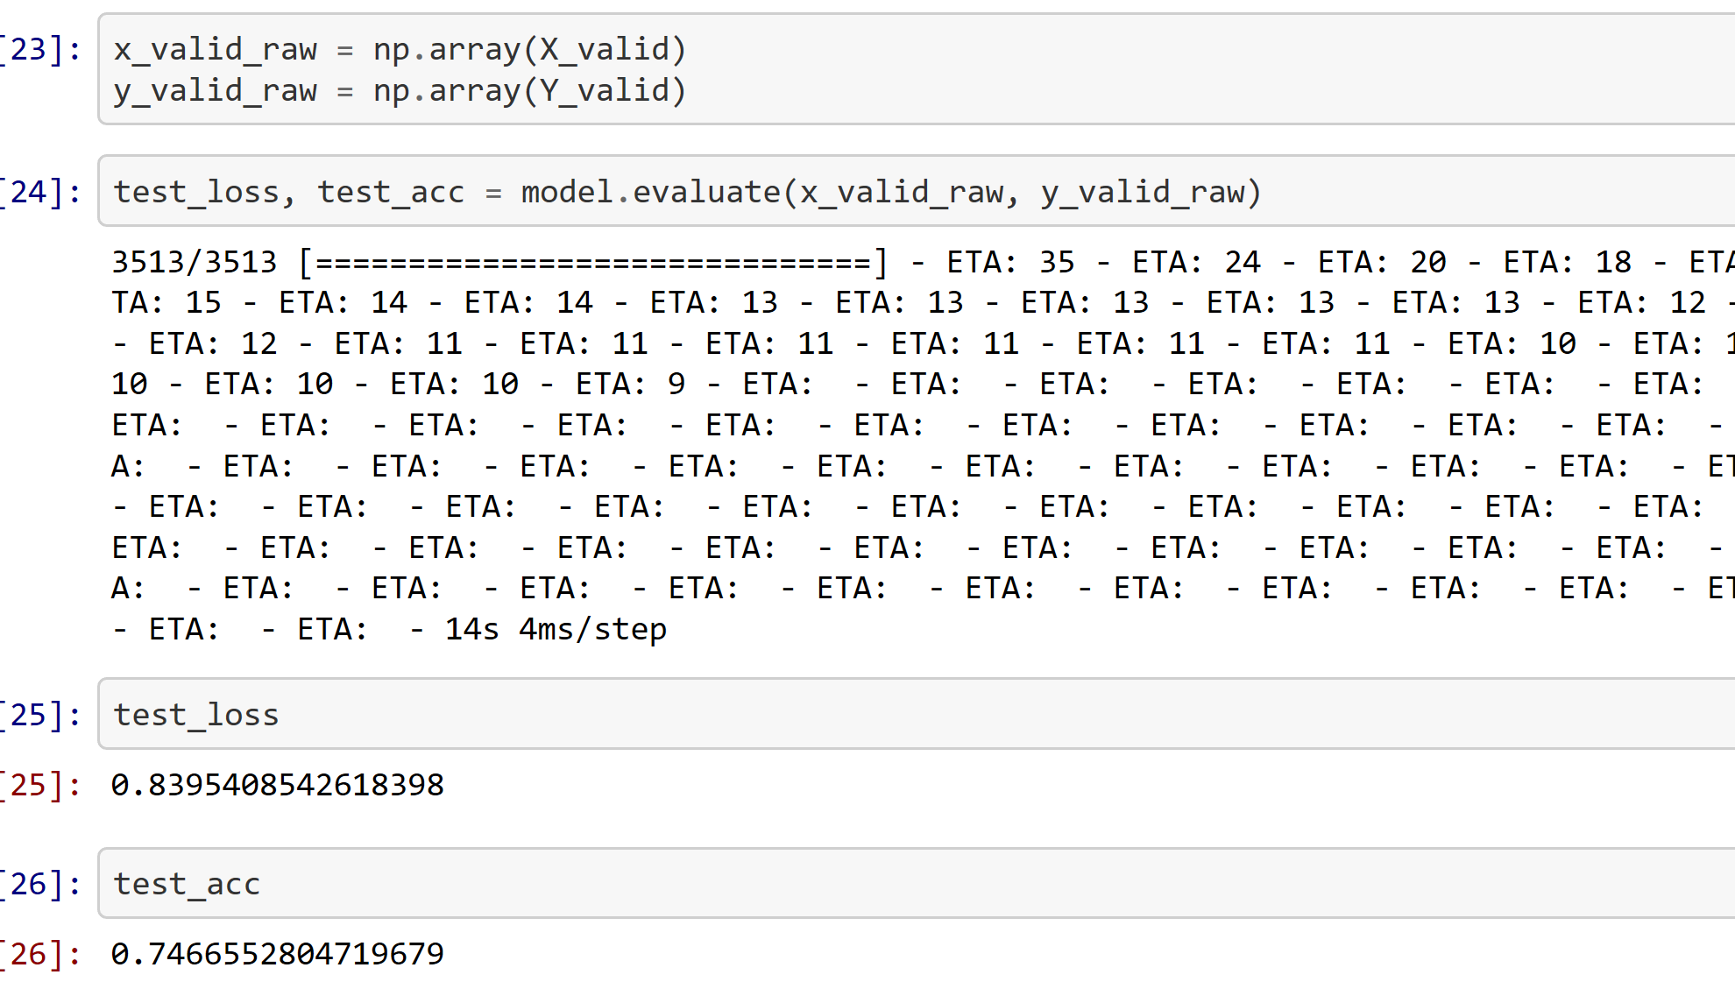
Accuracy and loss on Validation
After fitting the model and applying adam optimizer, model was evaluated on validation set of 3500 images. An accuracy of 74% and loss of 0.83 was achieved.

Slide 9
Exploring further
Accuracy can be improved to up to 85% using transfer learning with following CNN models
GoogleNet
ImageNet
ResNet

